Slide 1

INTEGRATORS
Prepared by Esra Cansu

Slide 2
WHAT’S THE INTEGRATOR OP-AMP
Integrator op-amp is a type of operational amplifier circuit that performs mathematical integration of an input signal. Integrating the input voltage using a capacitor in the feedback loop to create an output voltage proportional to its integral over time.

Slide 3
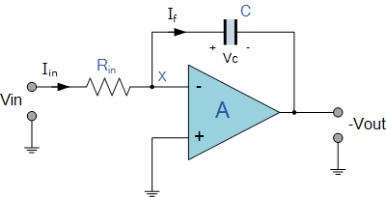
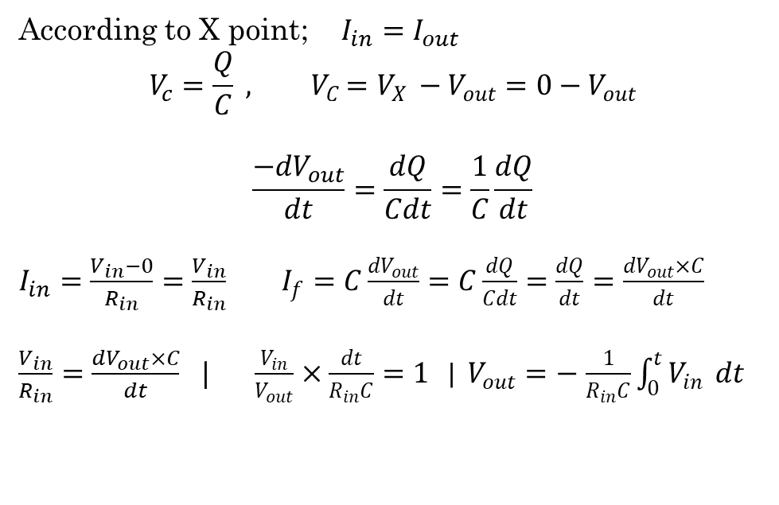
WHERE DOES THE FORMULA OF THE OP-AMP COME FROM?
According to X point; $I_{in}=I_{out}$
$$V_{c}=\frac{Q}{C} {, V}_{C}=V_{X }−V_{out}=0−V_{out}$$
$$\frac{{−dV}_{out}}{dt}=\frac{dQ}{Cdt}=\frac{1}{C}\frac{dQ}{dt}$$
$I_{in}=\frac{V_{in}−0}{R_{in}}=\frac{V_{in}}{R_{in}}$ $I_{f}=C\frac{{dV}_{out}}{dt}=C\frac{dQ}{Cdt}=\frac{dQ}{dt}=\frac{{dV}_{out}×C}{dt}$
$\frac{V_{in}}{R_{in}}=\frac{{dV}_{out}×C}{dt}$ $| \frac{V_{in}}{V_{out}}×\frac{dt}{R_{in}C}=1$ | $V_{out}=−$ $\frac{1}{R_{in}C}\int_{0}^{t}{V_{in} }dt$

Slide 4
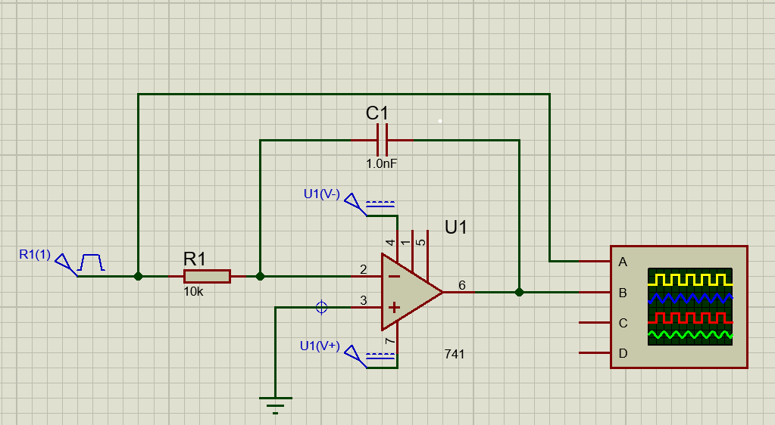
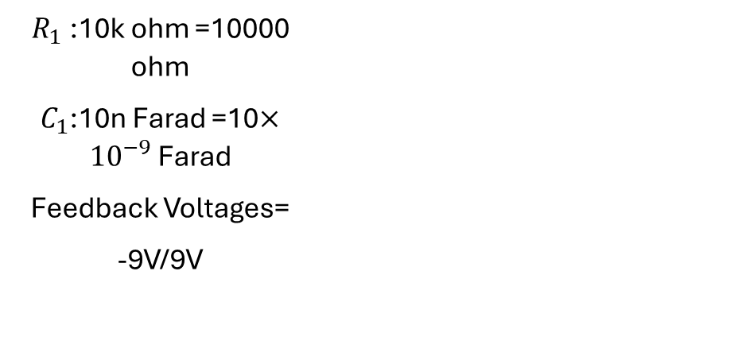
My Circuit
Components of the Circuit:
$R_{1}$:10k ohm =10000 ohm
$C_{1}$:10n Farad =10$×{10}^{−9}$ Farad
Feedback Voltages=
-9V/9V

Slide 5
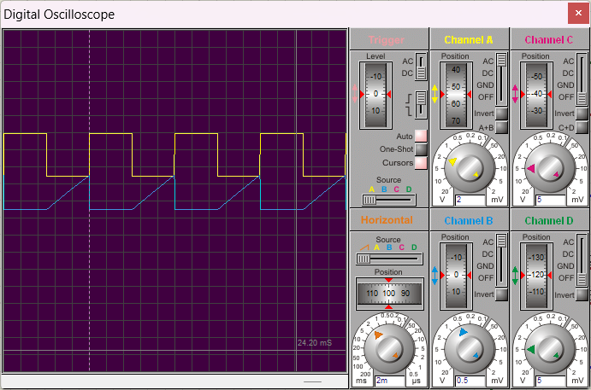
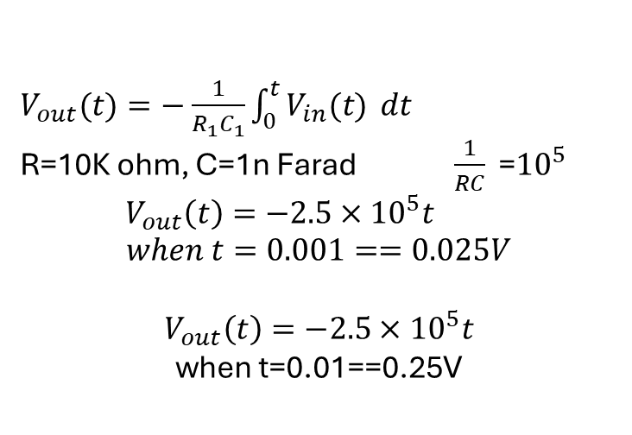
CONSIDERATION
$V_{out}(t)=−$ $\frac{1}{R_{1}C_{1}}\int_{0}^{t}{V_{in}(t) }dt$
R=10K ohm, C=1n Farad $\frac{1}{RC}$ =${10}^{5}$
$$V_{out}\left(t\right)=−2.5×{10}^{5}t$$
$when t=0.001==0.025V$
$V_{out}\left(t\right)=−2.5×{10}^{5}t$
when t=0.01==0.25V

Slide 6
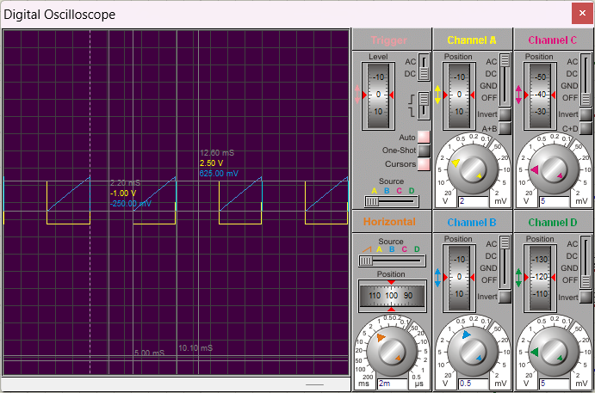

Slide 7
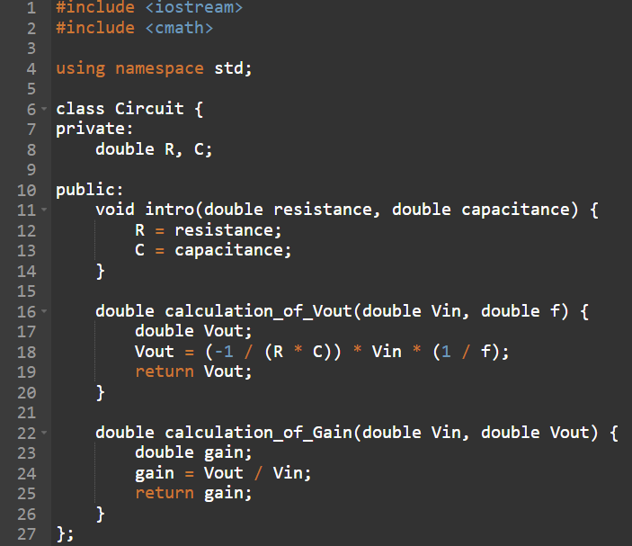
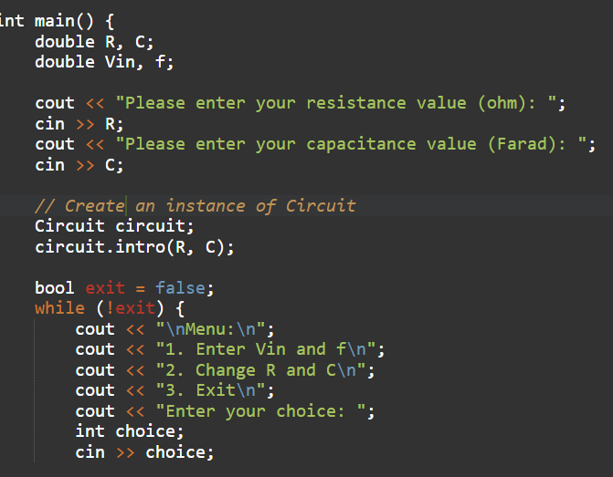
PROGRAMMING PART

Slide 8
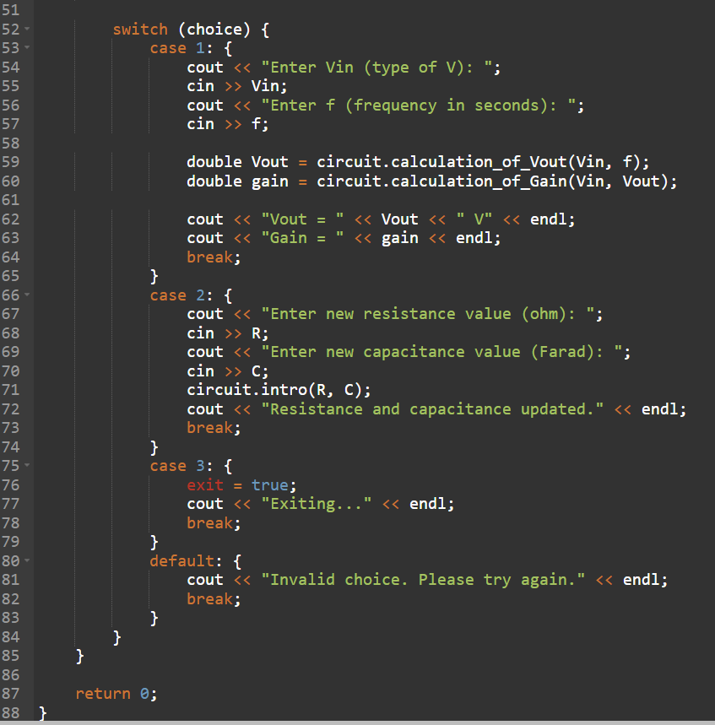
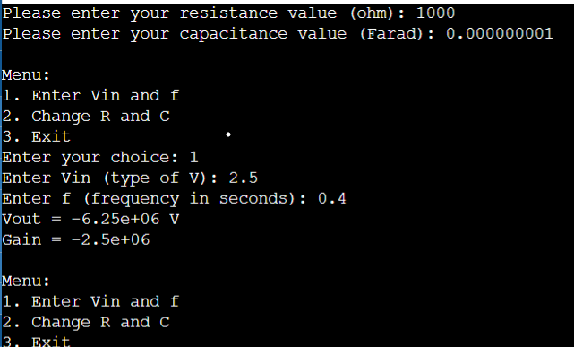
OUTPUT

Slide 9
THE AREA OF IN DAILY LIFE
Waveform Integration
Signal Processing
Filters
Mathematical Operations

Slide 10

THANKS FOR LISTENING

